Slide 1

Use of discrete event simulation (RSimmer) as decision-aid
in tackling ambulance response time breaches and handover delays
16 November 2022
Martina Fonseca, Senior Analyst
Digital Analytics and Research Team (DART), NHS England

Slide 2
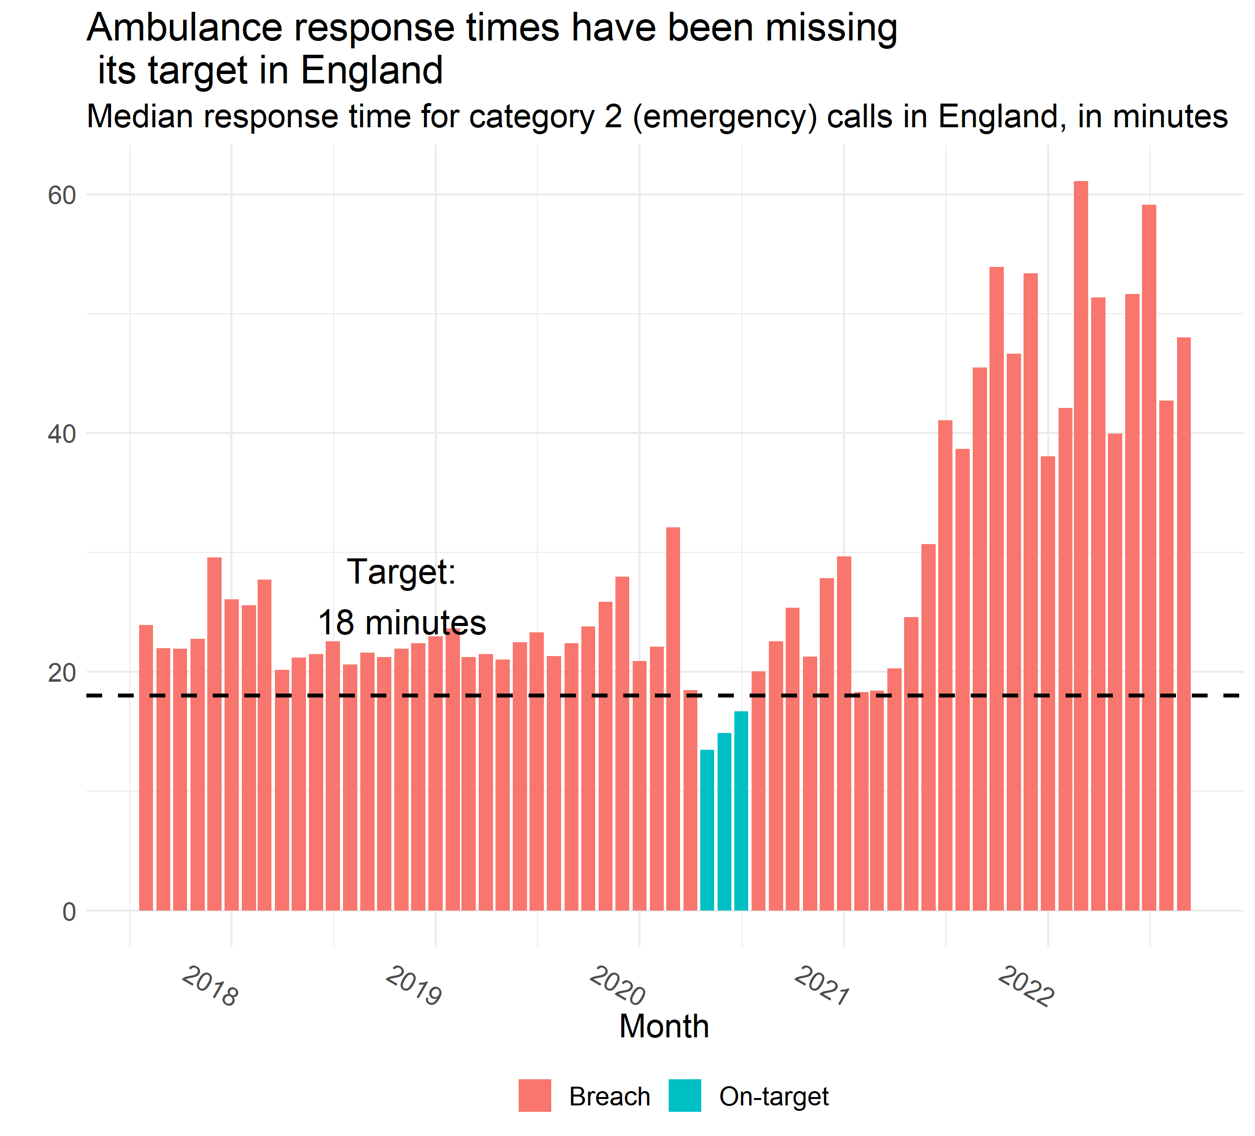
Ambulance performance has deteriorated considerably

Slide 3
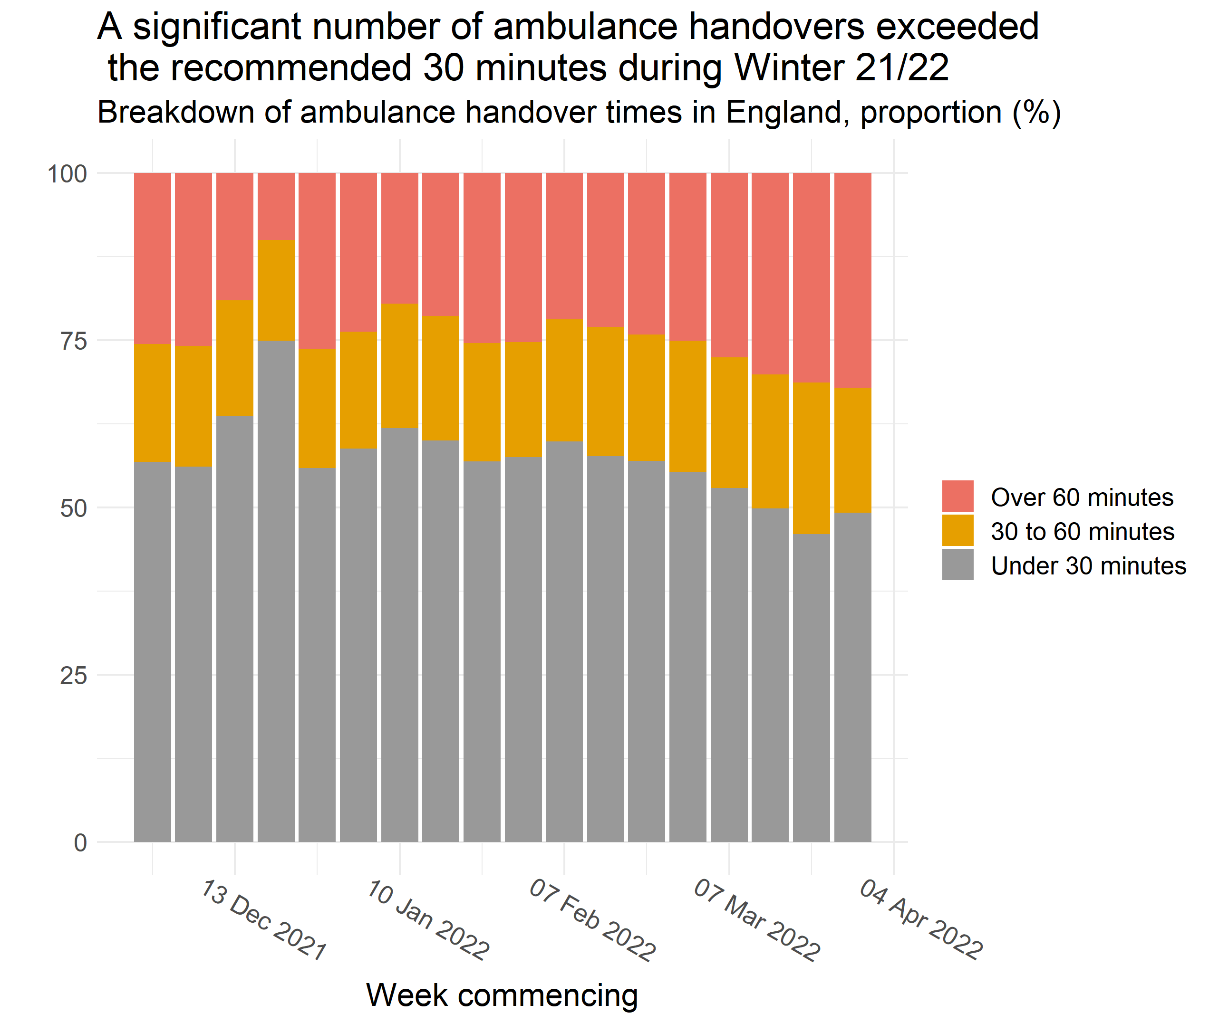
Ambulance performance has deteriorated considerably

Slide 4
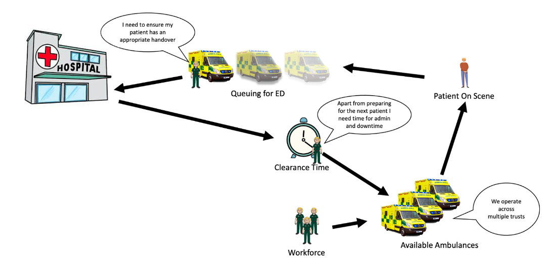
Understanding, addressing the problem
Much of it may not be in the sole direct gift of the ambulance service:
A&E availability for clinical handover
A&E occupancy
Bed availability in admitted patient care
Inpatient discharge (to home, social care, …)
For the ambulance setting, it is helpful though to understand:
Magnitude of trade-off between handover delays and response times
Impact of resourcing models
Impact of changes to job cycle time, demand

Slide 5
The setting formulated as DES / a queue
T: Call connect to resource allocation
T: Mobilisation and Travel to scene
T: On scene
T: Travel to hospital site
T: Time at hospital for handover
T: Time at hospital for clearance
999 Cat2 Response time
Clock start
999 Cat2 Response time
Clock stop
ambu1
Ambulance 1 job cycle time (in service time)
ambu2
Ambulance 2 job cycle time (in service time)
Incoming calls
deemed Cat2
(demand)
‘Call’ queue
for allocation
…
ambuA
Ambulance A job cycle time (in service time)
A on-duty ambulances

Slide 6
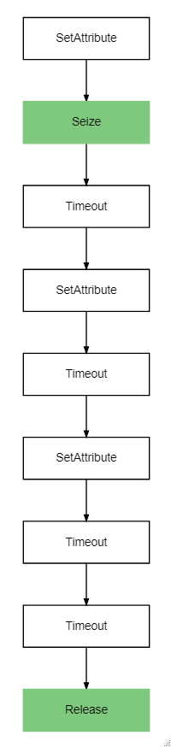

DES and simmer
In the context of ambulance to emergency department handover delays and elevated ambulance response times, build a prototype proof-of-concept discrete event simulation model (DES) to help understand the potential impacts
of:
interventions
factors such as demand, job cycle time components, vehicle capacity
on:
ambulances queueing at site
calls queued
call response times.
patient <-
trajectory("Cat2 patient path") %>%
set_attribute("t_Rclockstart", function(){now(CAD)}) %>%
seize("ambulance",1) %>%
timeout(g.T_allocatetomobilise + g.T_traveltoscene) %>%
set_attribute("t_Rclockstop", function(){now(CAD)}) %>%
timeout(function() {g.T_atscene + g.T_traveltohospital}) %>%
set_attribute("T_prehandover", function()rlnorm(1,g.T_prehandover_LN[1],g.T_prehandover_LN[2])) %>%
timeout(function() get_attribute(CAD,"T_prehandover")) %>%
timeout(function() g.T_clear) %>%
release("ambulance",1)

Slide 7
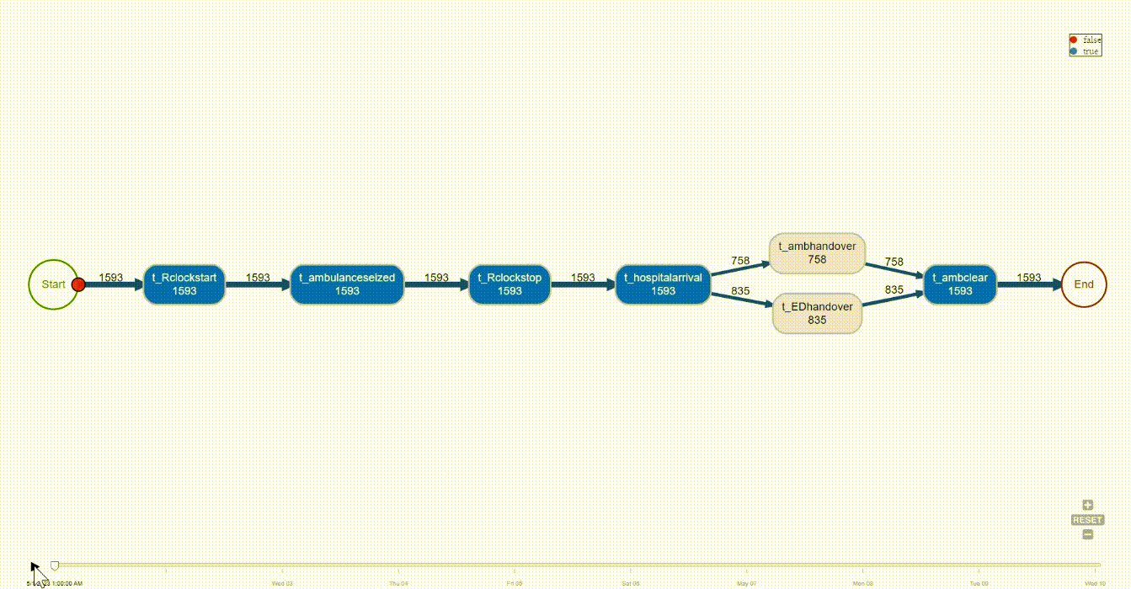
The setting formulated as DES / a queue

Slide 8
Example scenarios
In the next slides we show example outputs from a stylistic scenario modelling:
Baseline: stylistic trust
180 calls per day
Realistic job cycle time component times (mostly constant; lognormal for handover time)
23 vehicles
Hypothetical intervention: Resource redeployment to hospital site, based on triggers
Assume an intervention where staff of an ambulance (x2) could be reassigned to the hospital site to support with handover bays (3 bays per staff), on a shift by shift basis (1 ambulance : 6 site bays)
Redeployment from ambulance to site
Ambulance site queues exceed threshold
Redeployment from site to ambulance
Ambulance site queues not exceeding threshold AND Staff (bay) underutilisation at site AND 999 call queues exceed threshold

Slide 9
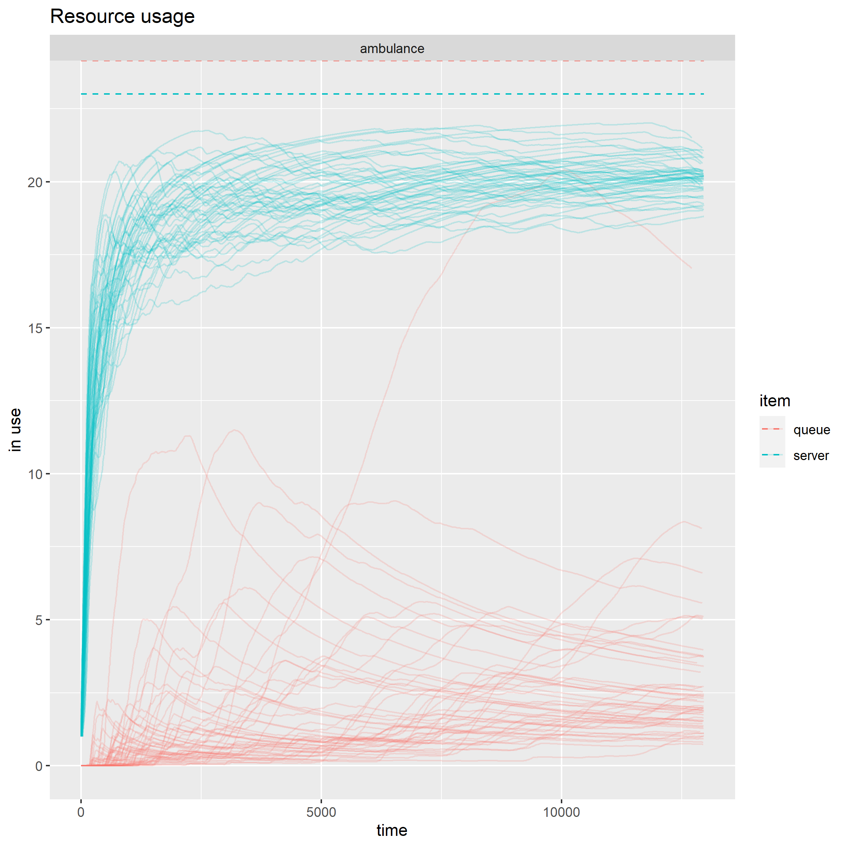
Results – resource usage
Baseline

Slide 10
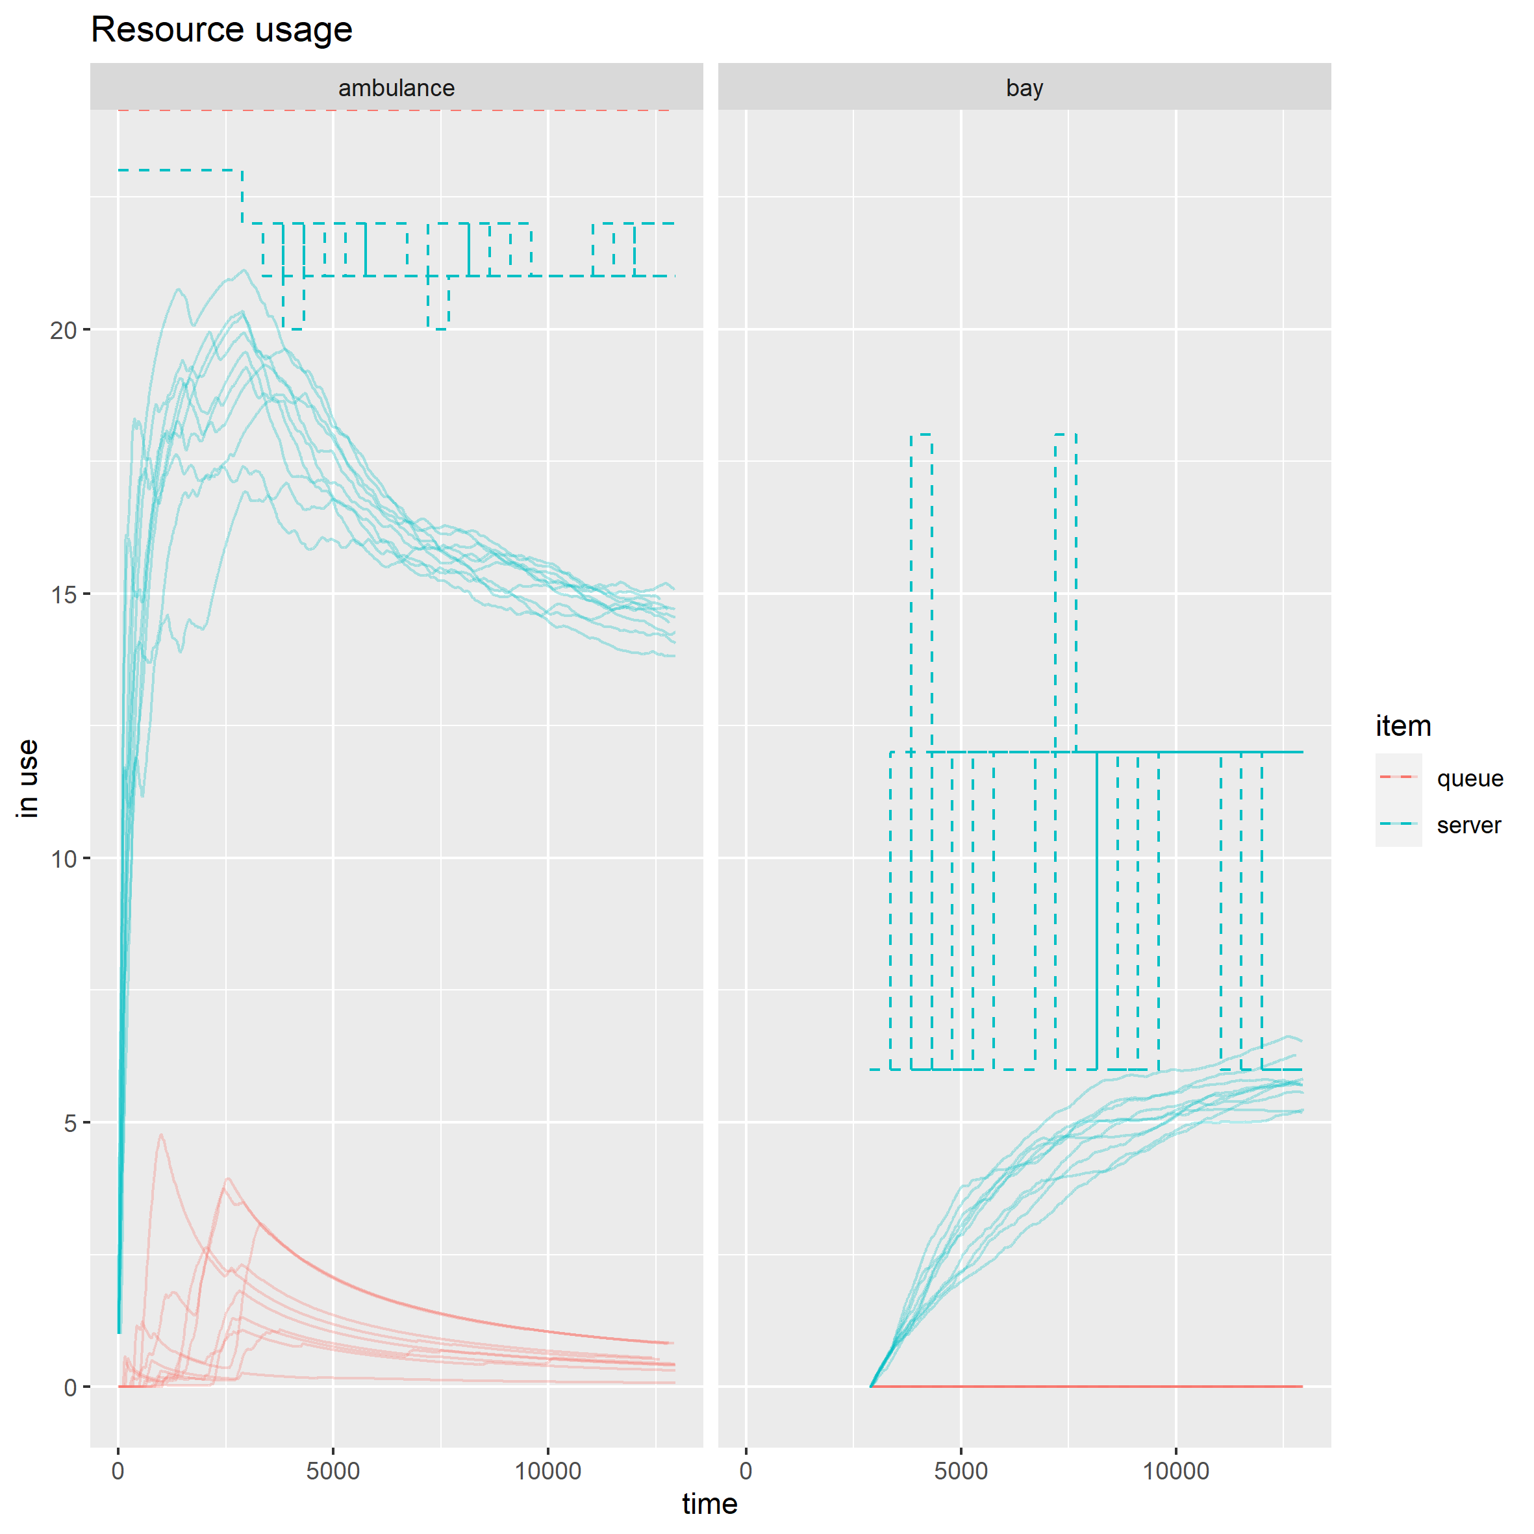
Results – resource usage
Baseline
Hypothetical intervention – redeployment to hospital site

Slide 11
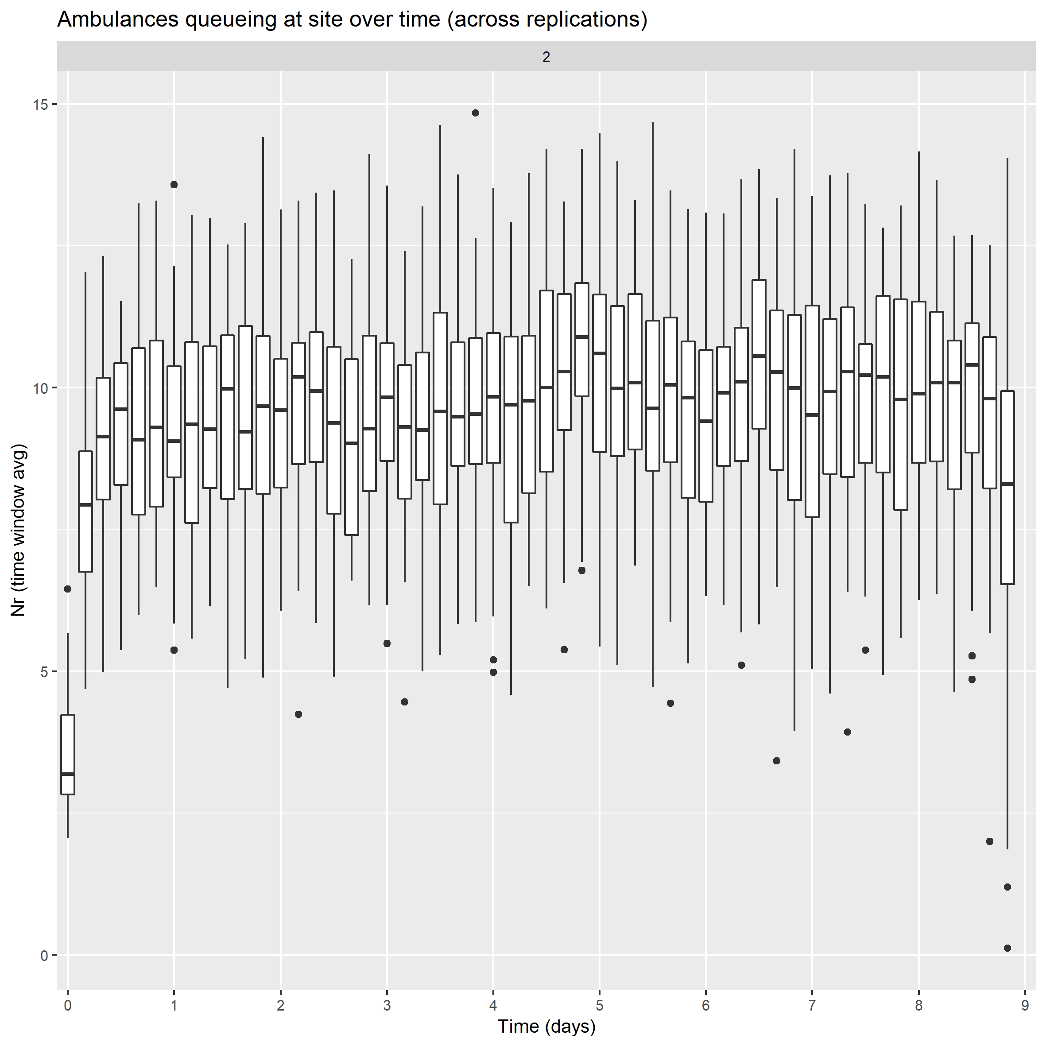
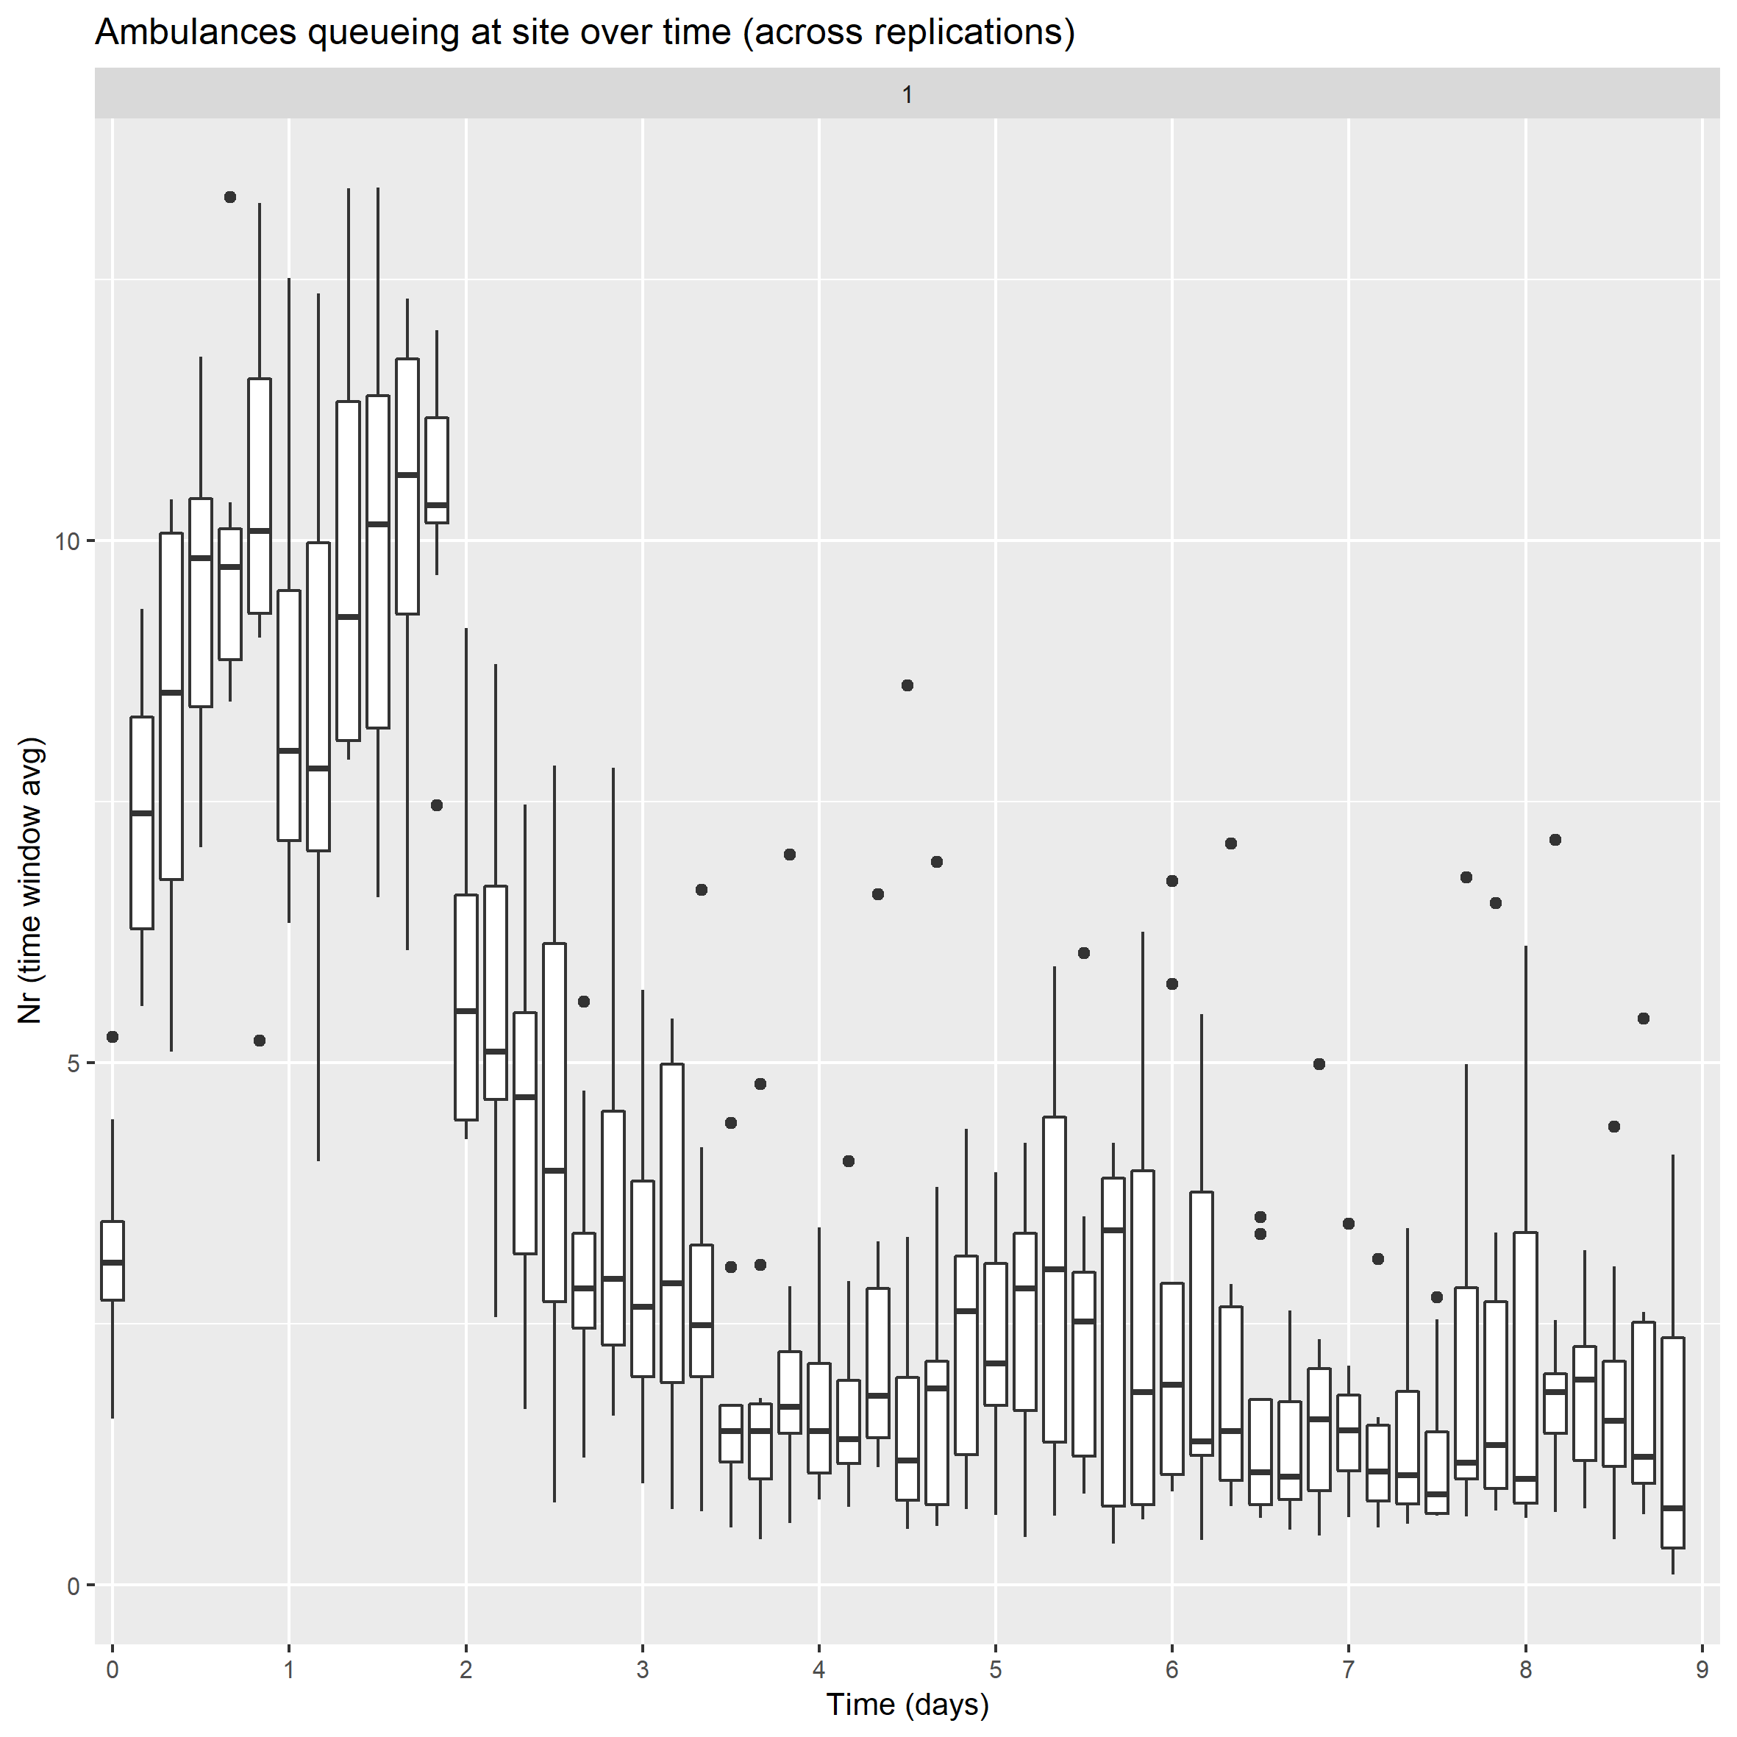
Results – ambulances queuing
Baseline
Hypothetical intervention – redeployment to hospital site

Slide 12
Opportunities
Application areas:
Policy and intervention design (problem diagnosis; what-if modelling)
Setting operational guidance
Theory-based evaluation
Avenues for potential development:
Use of event based data (ambulance CAD system; ambulance dataset) to improve demand profiles, parameters and validation
Multiple hospital sites
Demand distribution by other response categories or likelihood of see-and-treat or hear-and-treat

Slide 13



Thank you!
With thanks to NHS England CDAO and DART colleagues.
martina.fonseca@nhs.net
github.com/nhsx/ambulance-DES

